Slide 1
CLASS 5.A

Slide 2
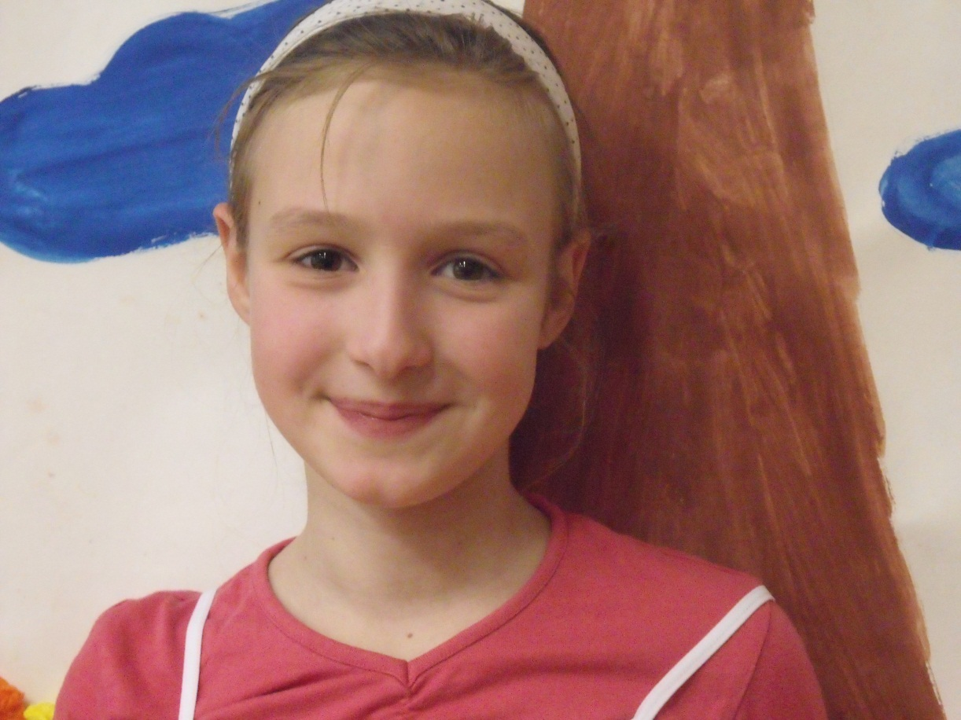
Petra
Hello,
My name is Petra Přibáňová. I'm a girl . I'm eleven. I'm from Czech Republic,from Zábřeh. My favourite colours are black ,white,blue and orange. My favourite animals are polar bears and snowy owls. I've got one sister, but I haven't got a brother.
Bye!
petruska.pribanova@seznam.cz

Slide 3
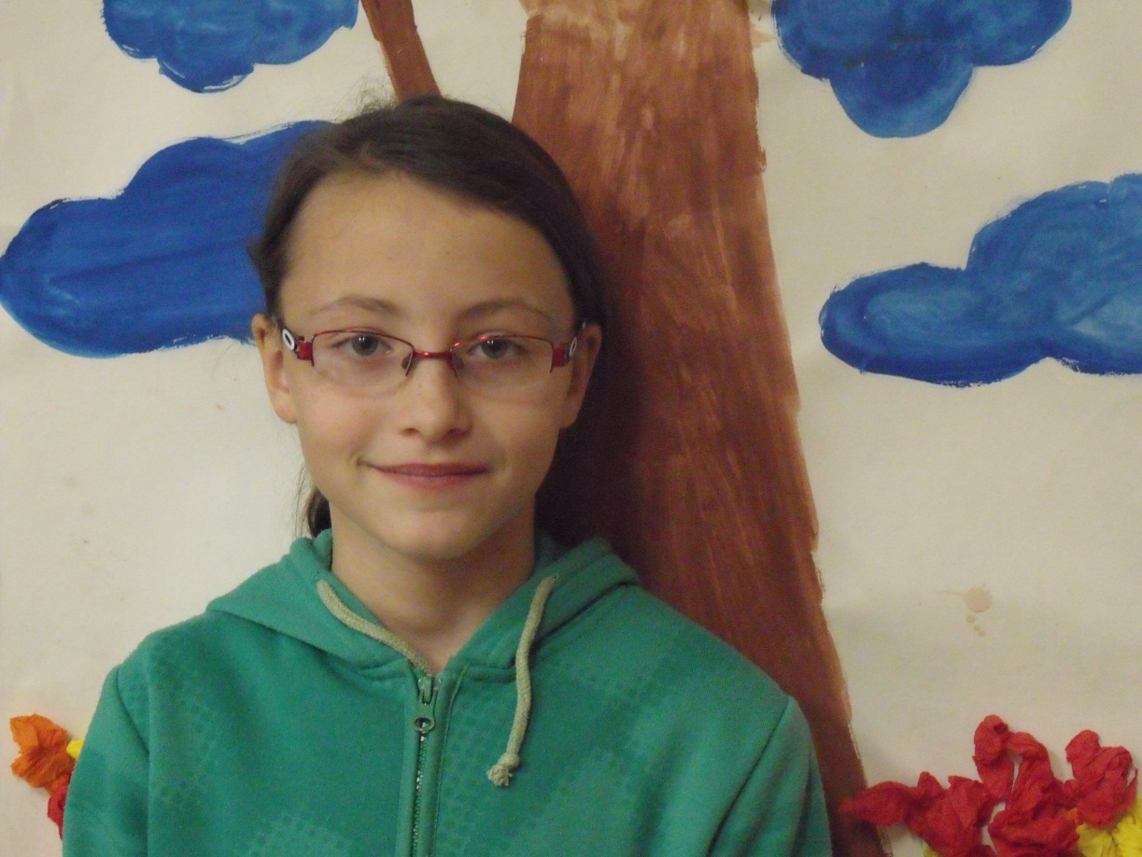
Míša
My name is Míša.
I am 10 years old.
I enjoy singing and dancing.
My favourite colours are: black, white, purple and red.
I’m from Zábřeh.
My favourite animals are horses, cats, rats and dogs.
misa.korni@seznam.cz

Slide 4
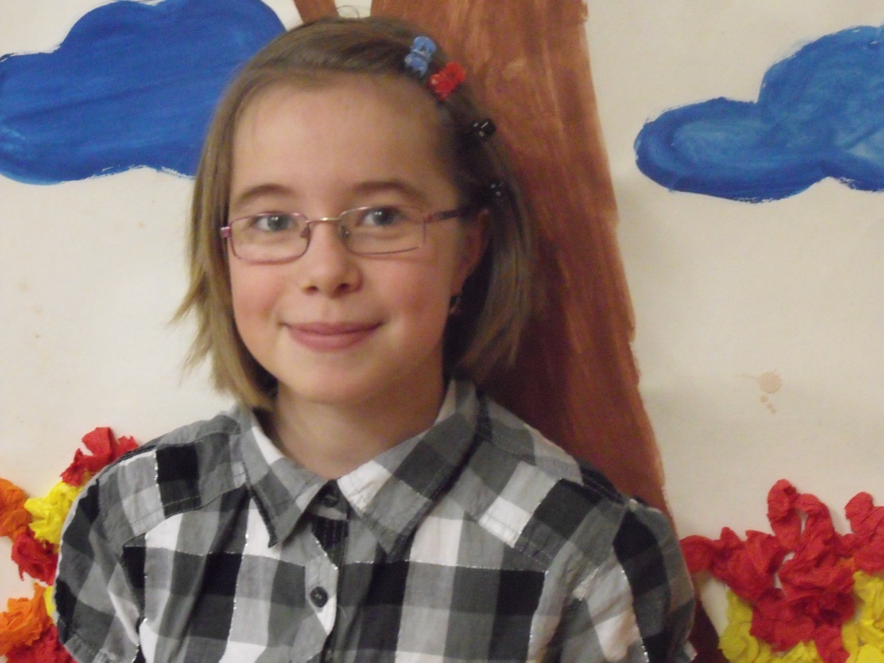
Hana
Hi!.My name´s Hana.I´m from Zábřeh.I´m 10. My favourite colour is black.My favourite animal is a horse.I go dancing on Wednesday and Friday. I play computer games.
Best wishes,
Hana
nanysokolova@seznam.cz

Slide 5
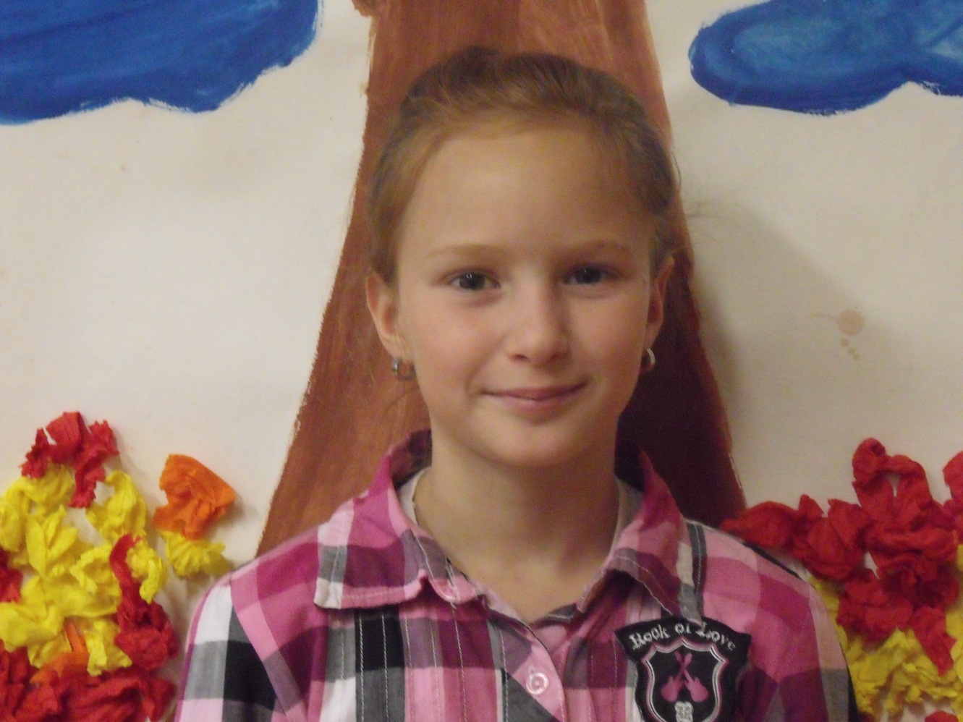
Nikola
Hello, my name‘s Nicol. I am from Czech Republic. I am 10.
nicolhobzova@seznam.cz

Slide 6
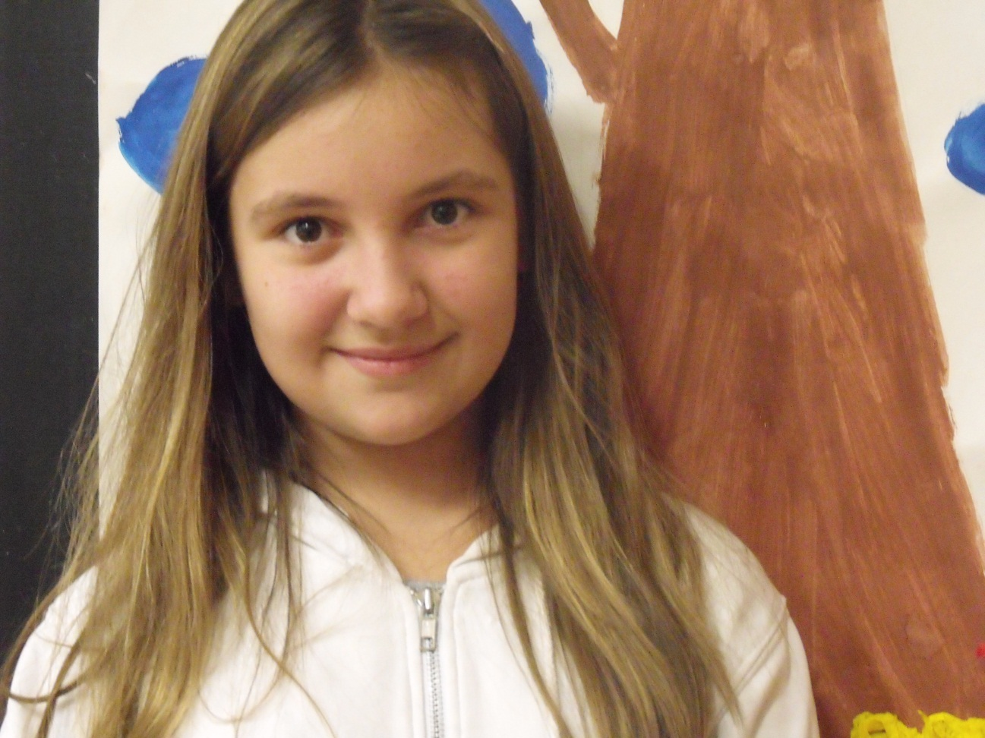
Míša
My name is Misa
I’m ten.
I live in the Czech Republic in the city Zabreh.
My favourite colour is dark red.
My favourite animal is a horse.
michaela.veiserova@seznam.cz

